Slide 1
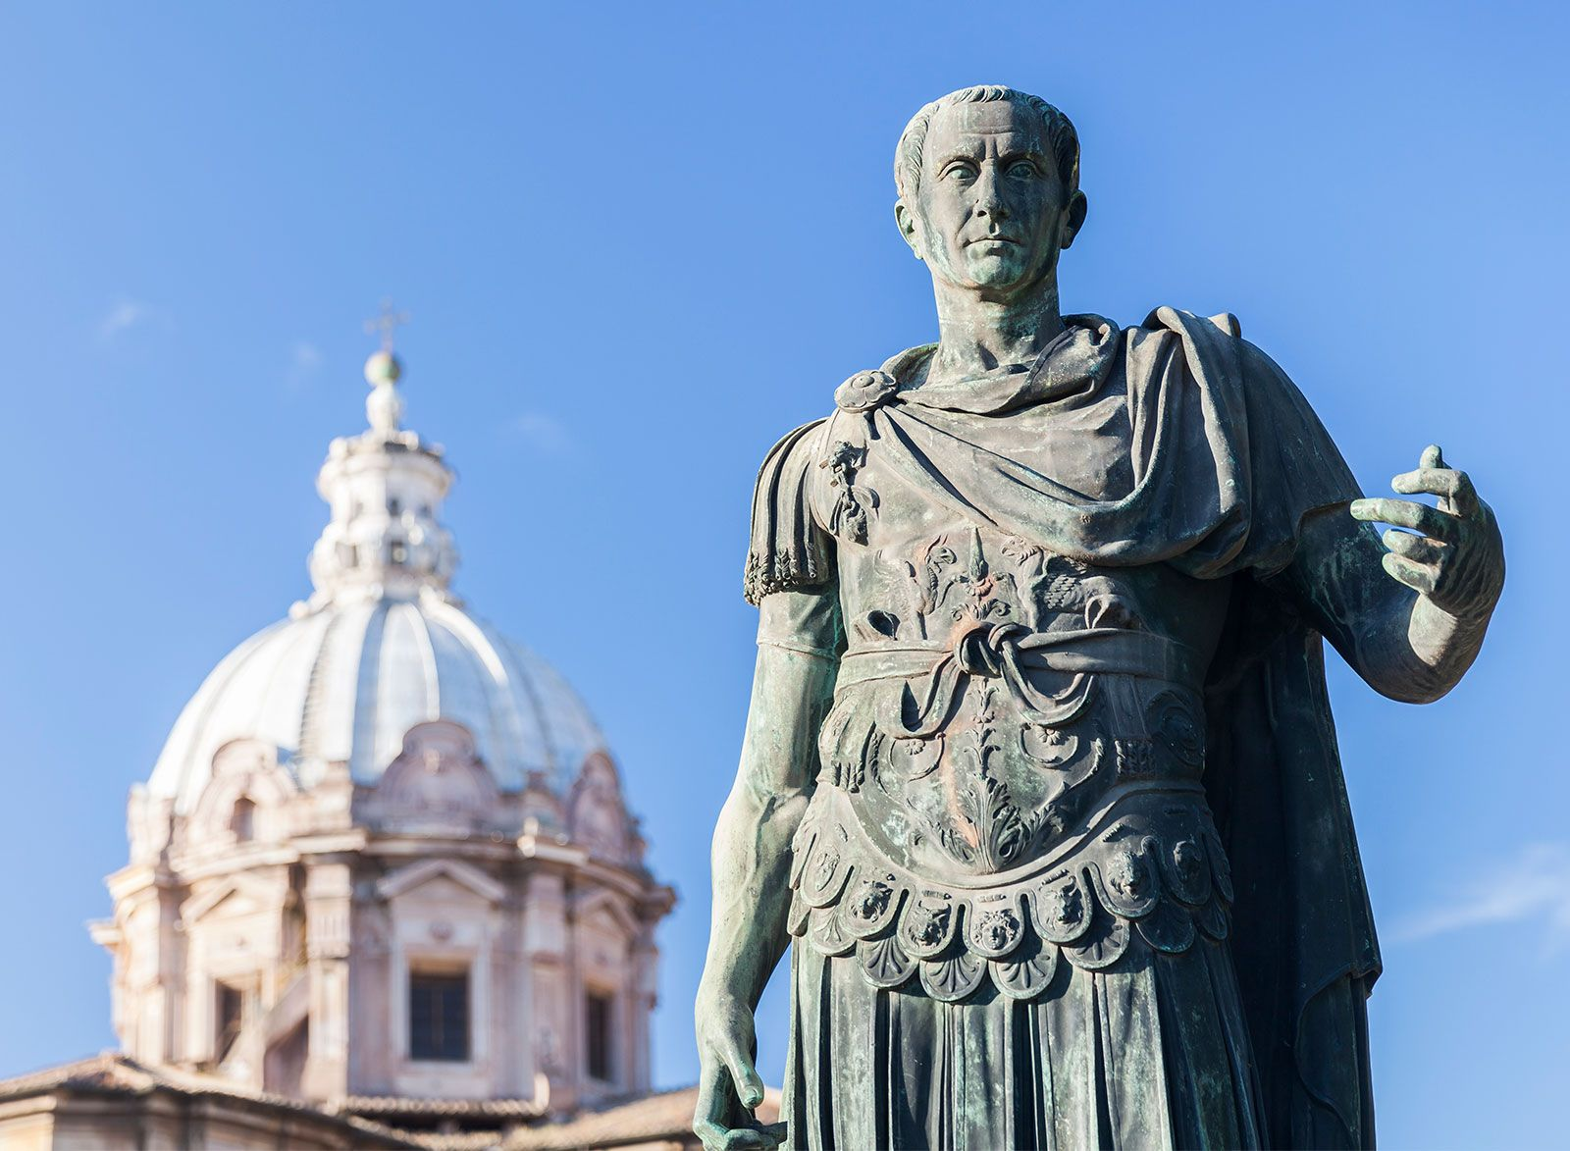
Assassination of JC
BOOK OUT – No Title/Goals
Week 7 Lesson 3
Ms Barrie

Slide 2
ACTIVITIES – 1 and 2
Read through the information sheet provided and highlight key words
Complete the questions
Fill in the blanks
Analyse the sources provided
Complete the questions
Analyse the sources

